Slide 1
Ari and Dante: Keyword’s lecture
A Presentation adapted from Nel and Paul’s Keywords for Children’s Literature (which includes a great deal of information about Y.A. Lit.)
Nel, Philip, and Lissa Paul. Keywords for Children's Literature. New York: New York UP, 2011. Print.

Slide 2
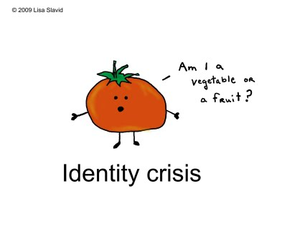
(PERSONAL) IDENTITY
OED: “The sameness of a person or thing at all times in all circumstances; the condition or fact that a person or thing is itself and not something else.” (109)
Is there anything problematic about this definition?
What exceptions might there be to this definition in your own experiences with identity?

Slide 3
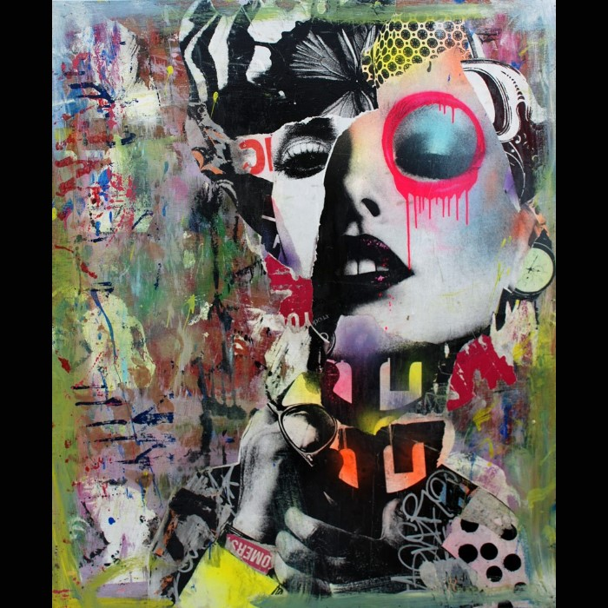
RECONSIDER IDENTITY THEN…
NOT an invariant condition.
DEVELOPMENTAL
ENTIRELY DEPENDENT upon the influence of variables: race, culture, religion, family, ideology, and embodiment (appearance/physical manifestation). (109)
The variables that make up our identities are complex and they don’t just stay the same always.
How might the variables on which identity is “ENTIRELY DEPENDENT” change?

Slide 4
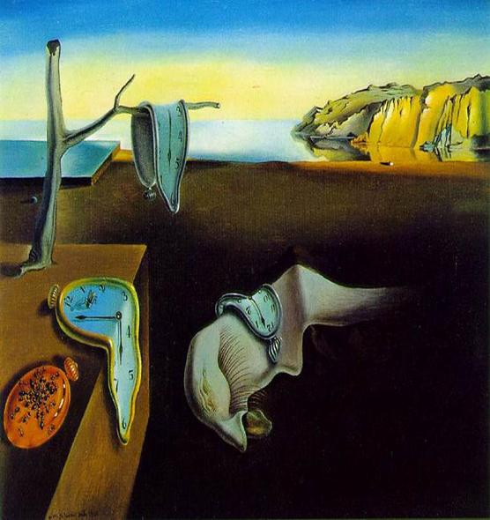
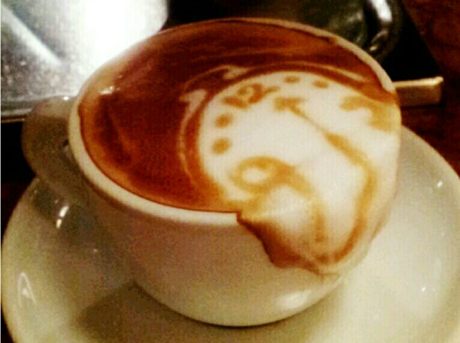
THE HANDS ON THE CLOCK CHANGE… AND SO DO WE…
The concept of identity is a product of it’s time – or at least the ways in which we think about identity are.
Modernists saw identity as an outward display of independence that is unified, authentic, and consistent over time.
Postmodernists argue that it is more fluid and provisional (arranged for the present, but with the possibility of change for the future). (109)
How might Salvador Dali’s melting clock art in his painting called “The Persistence of Memory” (1931) relate to our discussion of the fluidity of identity in respect to time?

Slide 5
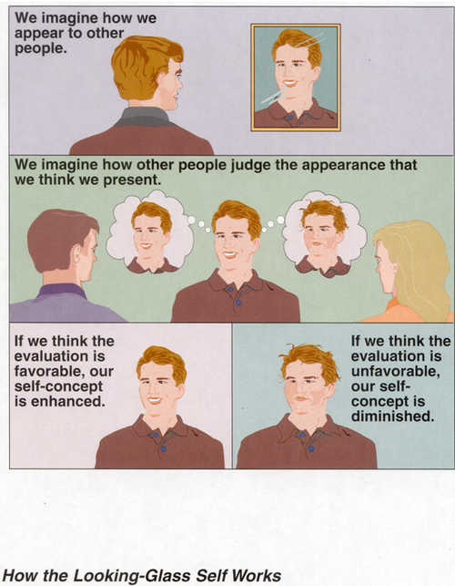
THE LOOKING GLASS SELF
CHARLES H. COOLEY (1902)
SOCIOLOGIST
Sense of identity emerges through how we imagine others see and react to us.

Slide 6
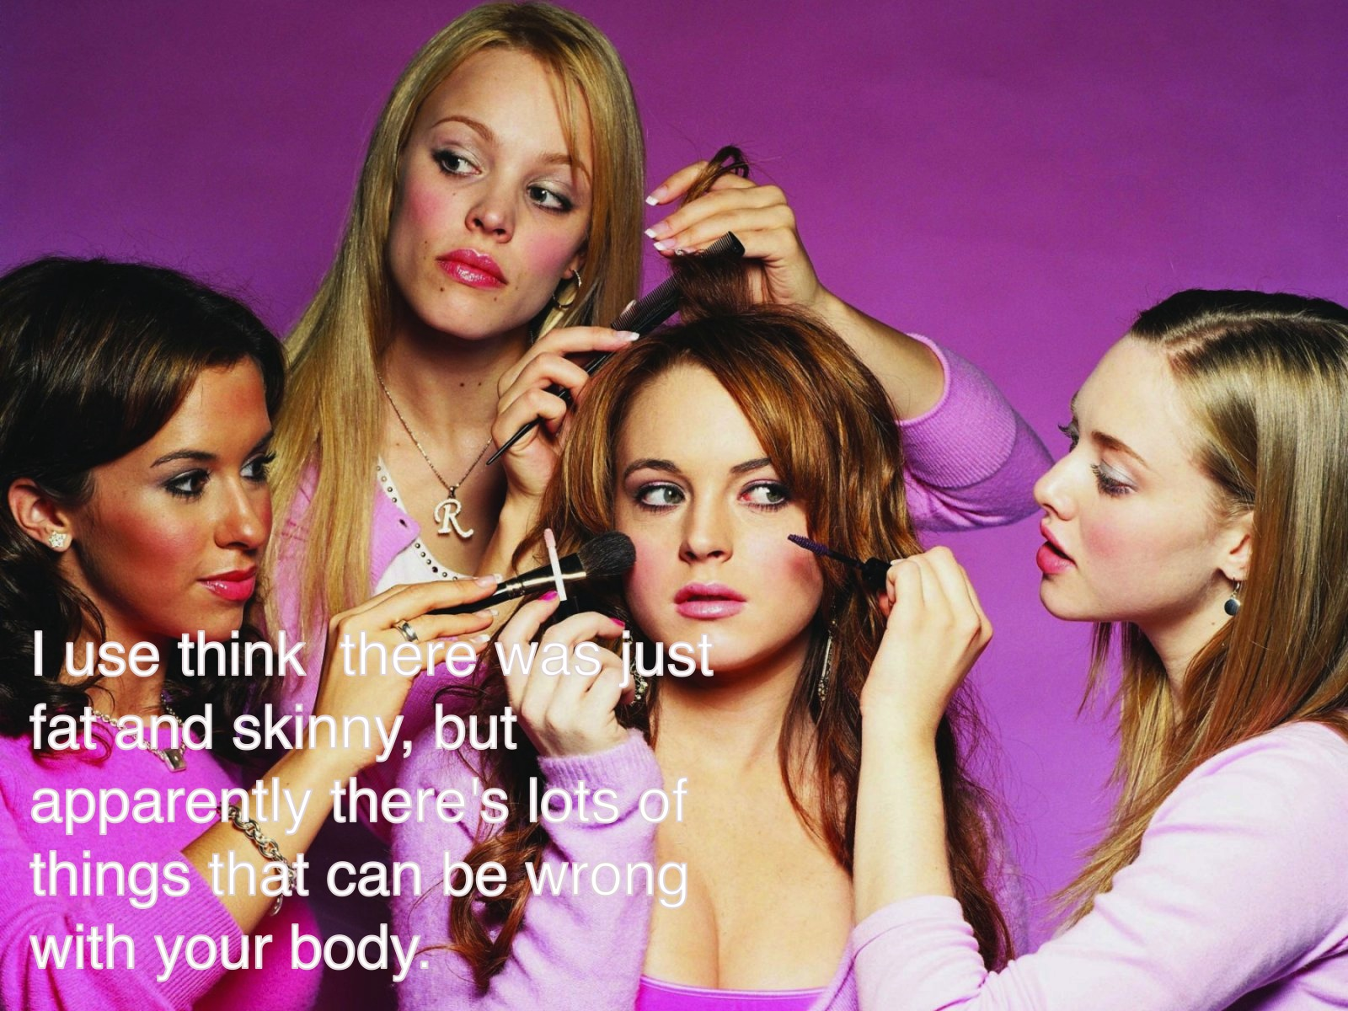
TYRANNY OF THE LOOKING GLASS SELF
REPOSITIONING the Looking glass self so that it reflects a different community to respond to – a community of whom one can be proud, rather than a bigoted community whom one should reject. (111)
Where and how can we see this in A&D?
There are a number of situations in the book.
http://youtu.be/LORyEX_5czg

Slide 7
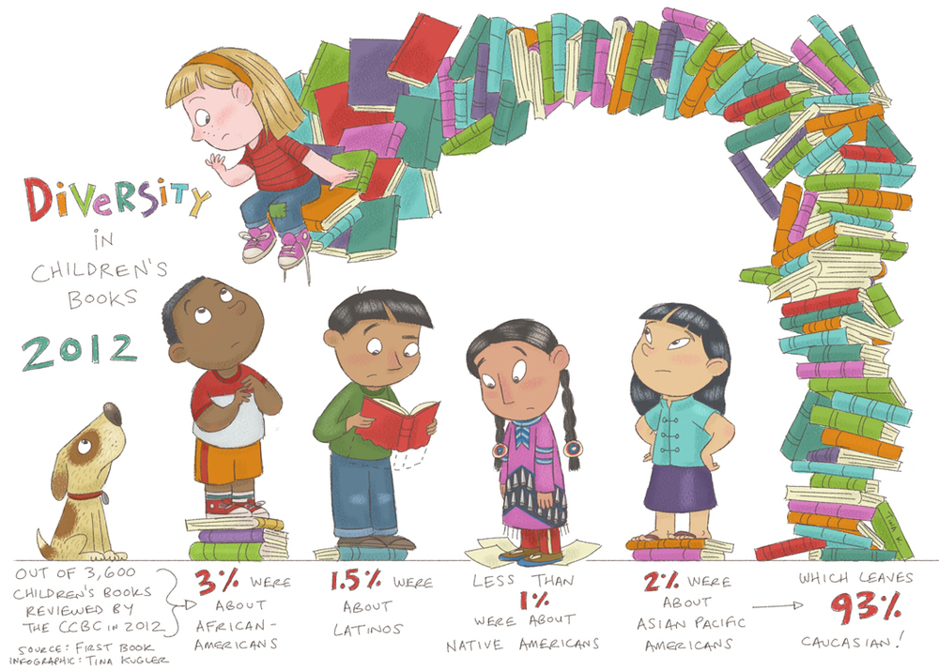
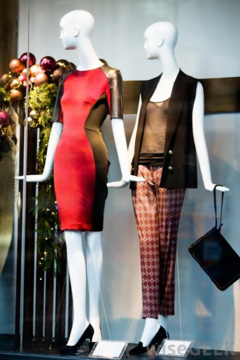
A RANGE OF MODELS
“Adults have long believed that it is crucial for children “to see themselves in the book” so that their particular identity structures are validated and affirmed. Black girls need stories about black girls, gay boys need to read about gay boys, and so on, so that they do not have to adopt alienating
and oppressive subject positions or feel invisible as they read.” (111)

Slide 8
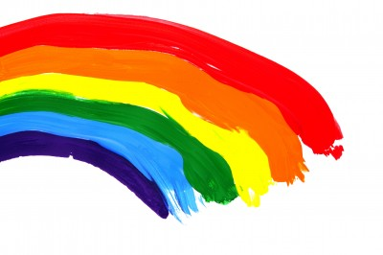
QUEER
Slippery word: etymology uncertain with academic and popular usage attributing conflicting meanings.
Mid-nineteenth century used as a pejorative (expressing contempt or disapproval) term towards male homosexuals.
Neg. connotation continues when used for abusive purpose.
In recent years: an all-encompasing term for culturally marginalized sexualities – gay, lesbian, bi, trans, and intersex (GLBTI) (186)
Literature Professor’s introduction to Queer Theory / See:
http://youtu.be/Ic1jBjiccYo

Slide 9
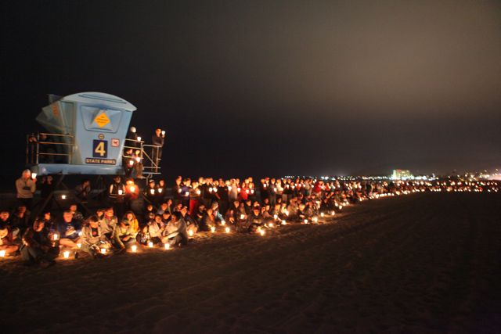
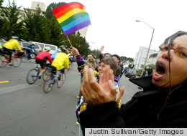
POLITICAL AND THEORETICAL USAGE
Used as a theoretical strategy for deconstructing binary oppositions that govern identity formation.
The strategy refuses to settle comfortably into a single classification, preferring instead to traverse several categories that would otherwise attempt to stabilize notions of chromosomal sex, gender, and sexuality.
Late 1980’s “queer” became a part of a demand for the recognition of the severity of the AIDS crisis with the “Queer Nation”, AIDS activist group. (186)
The pictures are of the San Francisco to L.A. AIDS bike ride fundraiser.

Slide 10
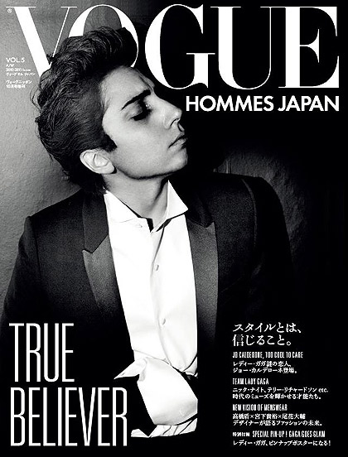
NOTION OF “PERFORMATIVITY”
JUDITH BUTLER: Gender Trouble: Feminism and the Subversion of Identity (1990) and Bodies that Matter: On the Discursive Limits of Sex (1993)
GENDER IS NOT WHAT ONE IS, BUT WHAT ONE DOES.(187)
“The concept of the performativity has provided ways for thinking about the processes by which discourse and language construct identity, the functioning of social norms, and how disruptive performances of gender and sexual identity (e.g., drag and parody) can subvert identity categories, as well as reinforce existing heterosexual structures.” (187)
The picture to the right is Lady Gaga. Could you tell at first that she female? Is she a woman in this picture or does her performance of male gender designate her as a man? Queer identity pushes against these binaries.
Where in the novel can you see examples of disruptive performances of gender? How do others react? (positively/negatively/provide evidence)

Slide 11
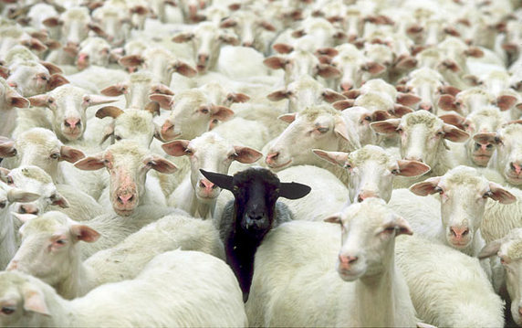
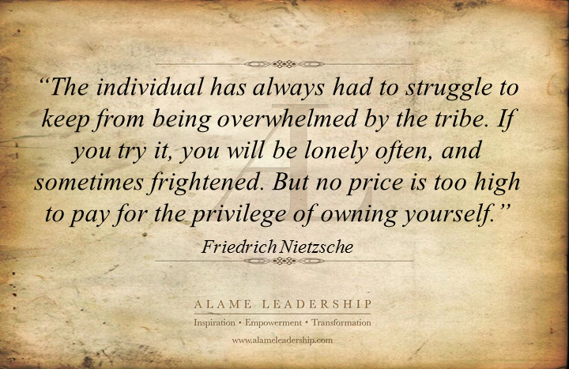
NONCONFORMITY
“The most successful queer stories “queer” their readers by provoking them to query the assumptions that underpin notions of normal and abnormal identity, especially sexual identity.” (189)
To what extent do you think the idea of nonconformity in Queer lit. is of interest to high school students? Why?
Realistic fiction with gay/lesbian characters attempts to reflect the diversity of sexuality and the divergent attitudes towards nonconformity. (188)
What aspects of the novel are realistic? Which aspects are romantic or fantastic?

Slide 12
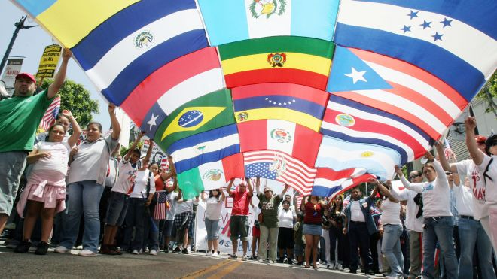
LATINO/A
Designates a resident of the U.S. who is of Latin American descent.
“HISPANIC”: privileges Spanish descent over Latin American origins. It also assumes that a person speaks Spanish.
Insistence on “Latino” over Hispanic in the 1980’s.
Felix Padilla (1985): explains “Latino” as “a politicized identity category, the moniker has enabled the mobilization of diverse ethnic, cultural, and national groups into an imagined community predicted not just on linguistic and hemispheric affiliations, but also on shared experiences in the U.S. with racism, poverty, and other social challenges.” (133)
What similarities can you already see between the Latino and Queer definitions in Keywords??

Slide 13
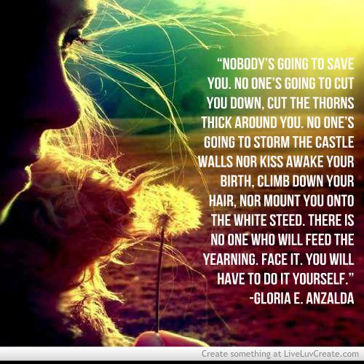
GENDER and LATINO/A
Since default references use the masculine Spanish form of the adjective “Latino”, “Latino/a” soon became commonplace to make the identity/political movement inclusive of women.
“Latin@” has recently come into use with some groups of people, although this isn’t a perfect solution (see how the ‘a’ is inside of the ‘o’ as if it were subsumed).
(134)

Slide 14
Latino/a Literature
Simple sense: Refers to lit. by Latinos/as that speaks to Latino/a experiences.
There are authors of mixed backgrounds though and authors that write about Latino/a experience that are not Latino/a.
Alma Flor Ada (2003) states that “The merit of a book is determined not by the heritage of its author or illustrator, but by their intention, knowledge, sensitivity, responsibility, and artistry... Yet there is an inner look into culture that is not easily acquired and requires long contact with people of the culture and its environment. The deep experiences of a people can seldom be told authentically from the outside.” (135)
Above is a book of poetry by a Chicana writer you should check out to explore Latino/a themes even further.

Slide 15
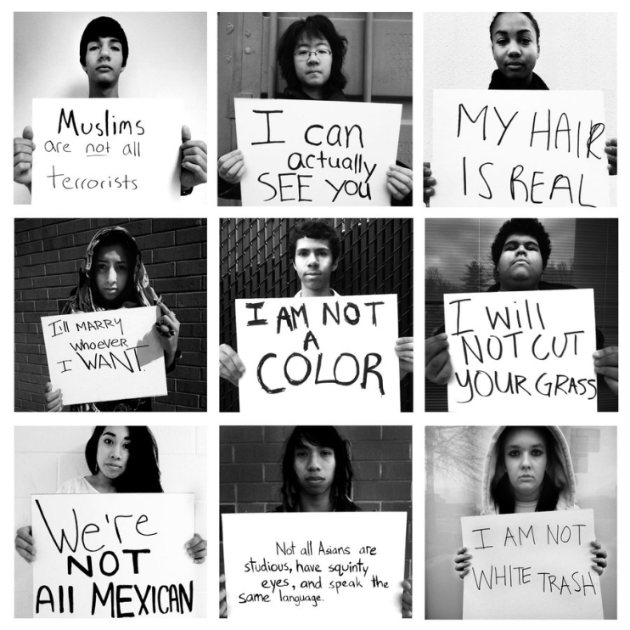
A Fight against Stereotype
These texts serve to reflect and reify (make something abstract more concrete/real) misconceptions in popular American imagination and media where “Latinos are perceived primarily in terms of assumed patterns of cultural behavior… by vaguely defined and ahistorical interpretations of the meaning of ‘Hispanic ethnicity’. (136-7)
The very convenience of labels such as “Hispanic”, “Latino”, and even “Latino/a” is the root of the problem with them. It is best to understand these as superficial descriptors and not as signifiers of a homogenous (all the same) group of people. (137)
How are Dante and Ari different even though they are Mexican American? To what extent and how do they share cultural similarities?

Slide 16
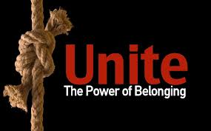
IMPORTANCE IN DAILY LIVING?
Identity is a fundamental part of knowing where we belong.
Even if you aren’t Queer or Latino/a, you have learned about living with identity that can be both fluid and hard to define.
You should be able to return to the novel with a better idea about the social/historical context.
You should be able to better understand the process of identity that can help you to know yourself and others with greater maturity and insight.
This information is relevant for when you feel like you don’t belong. Labels are superficial and often times the ways in which we come up with them is an arbitrary and political product of the times we live in.
Be proud of who you are based on your merits as a person. Don’t let ignorance and bigotry shame you into invisibility.
Consider how often you think about who you are. Even if you don’t formally sit down to do it, think of Cooley’s Looking Glass Self.: al l throughout the day you get feedback about who you are. Don’t you think it’s important to know how you are defined – how you define yourself?

